Slide 1
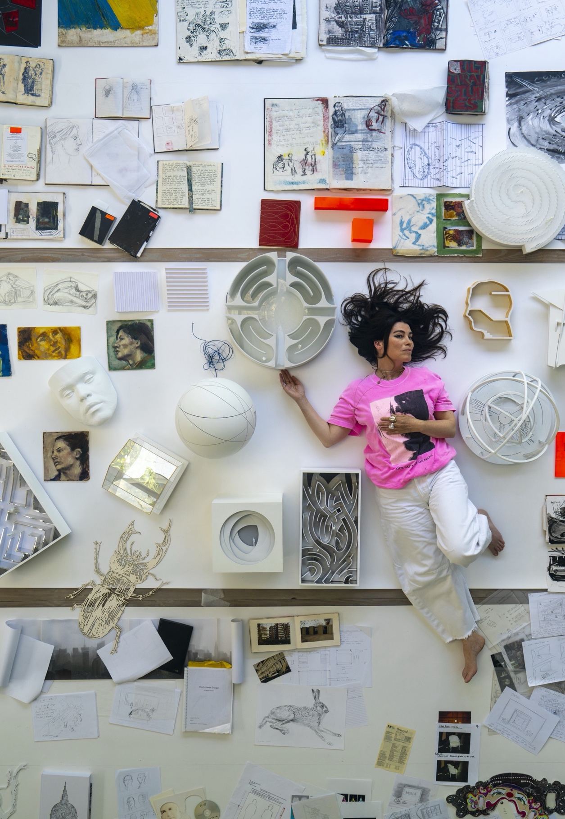
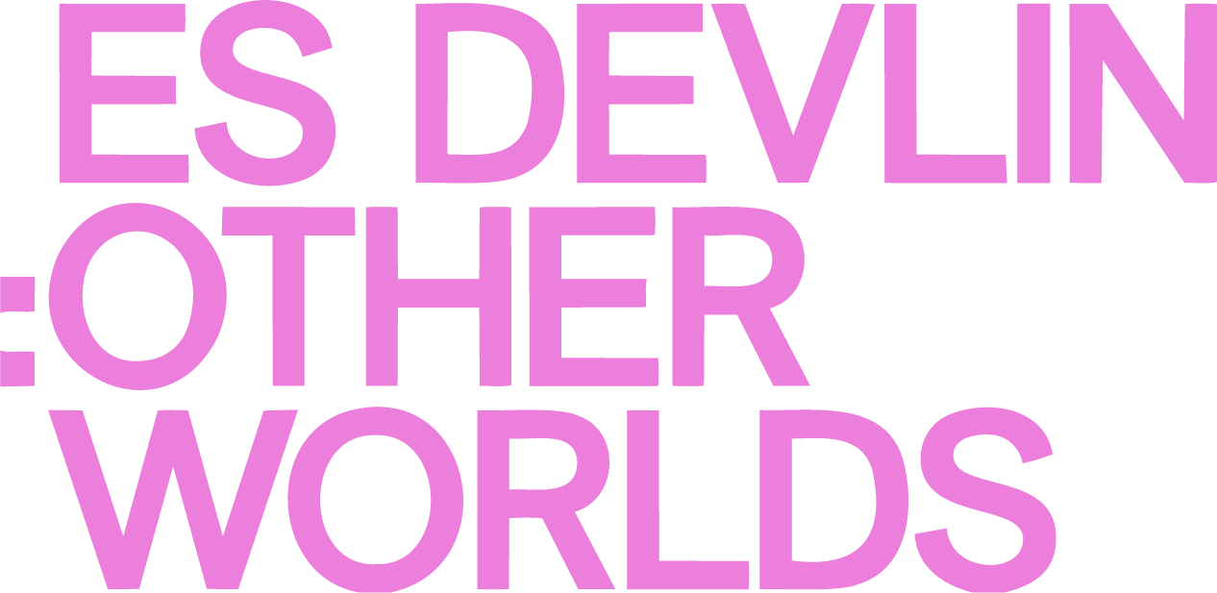
Es Devlin has created spectacular sets and ‘stage sculptures’ for musicians like Beyoncé, Adele, and U2, and events such as the London Olympics and the Superbowl. This will be her first retrospective in Europe, tracing her creative evolution and practice.
  Whether it’s for an arena, stadium, opera, gallery, or museum, the British artist and designer’s creative instincts – first honed through her start in small-scale theatre – allow her to craft and manipulate space, light, sound, movement, and even time around her audience. Devlin blends stage design with installation art, and autonomy with co-production, to create immersive worlds whose impact outlasts their often fleeting physical existence.
2 OCTOBER 2026 – 4 APRIL 2027

Slide 2
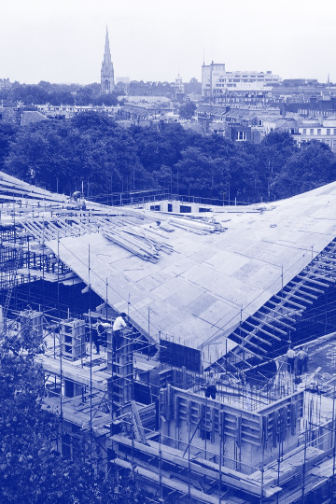
the Design Museum
  The Museum was founded in 1989 by Sir Terence Conran. Just like design itself, we’re multifaceted and cross-disciplinary, offering an ever-changing space for the public, industry and education to come together and explore new ideas.
how to use these notes
  Exhibition notes can be printed and distributed to students for reference while visiting the Design Museum or to use as classroom posters or handouts, or shown as a slideshow to support class discussion and participatory learning.
  We’ve selected a few objects which we think are relevant to teaching D&T and the wider curriculum, but this is only a starting point. We invite you to pick your own favourites to explore further – you or your students could even use this slideshow template to create more highlight slides!

Slide 3
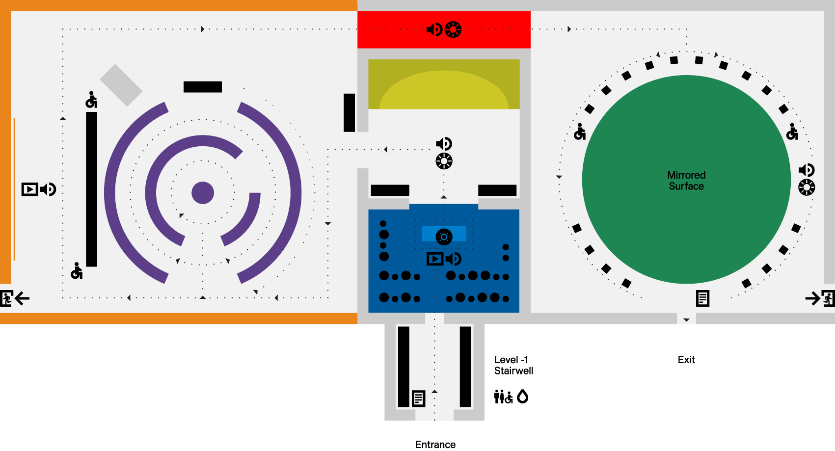










exhibition highlights and sensory guide
KEY
Studio Highlight 01
Come home again Highlight 02
30-year-desk Highlights 01, 03,04
Archive unboxed Highlight 02
Line of light
An infinite library
02
02
02
seating
04
Direction
01
03
Bright light
01
Low light
Large print guide
sound
Moving image with sound
Drinking water
Fire exit
toilets
Wheelchair accessible

Slide 4
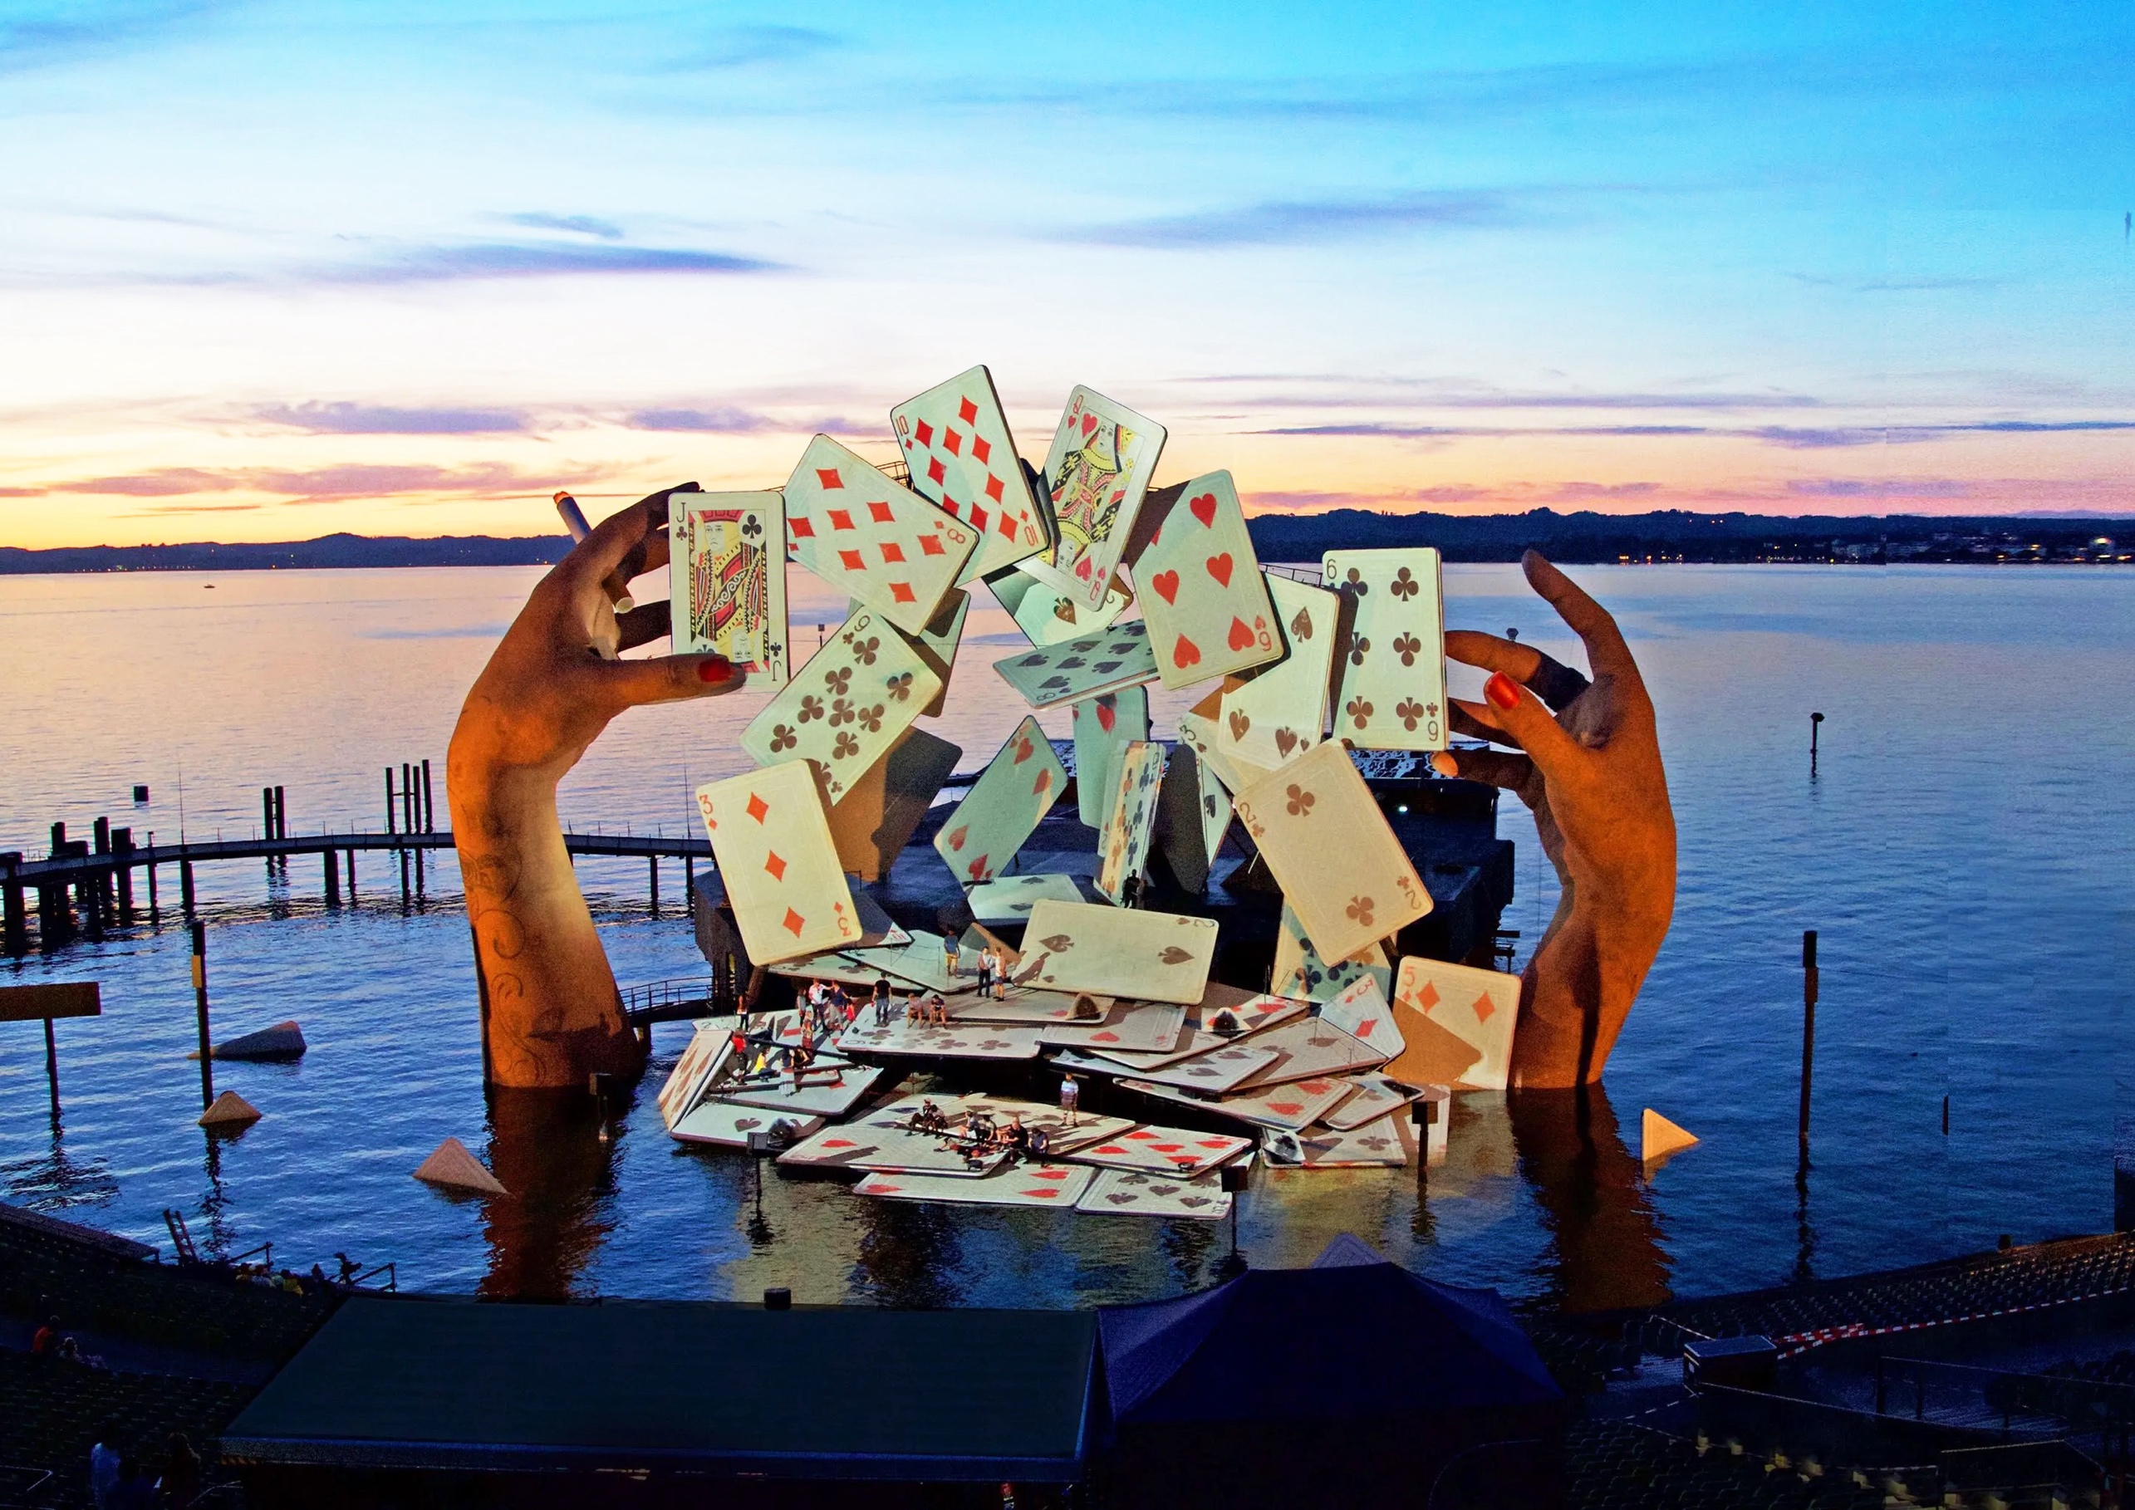
exhibition highlight 01 mêlons! coupons!
“Mêlons! coupons!” is French for “shuffle! cut!”, as done with a pack of cards.
    What do you think this image shows? (look closely…)
    These are modelled on Es Devlin’s own hands! Hands are often considered one of the most difficult things to depict or recreate – why do you think this is?
STILL FROM PRODUCTION OF CARMEN, 2017. DIRECTOR: KASPER HOLTEN. DESIGN: ES DEVLIN. CHOREOGRAPHER: SIGNE FABRICIUS. VIDEO DESIGN: LUKE HALLS. COSTUME DESIGN: ANJA VAN KRAGH. LIGHTING DESIGN: BRUNO POET. LEAD ASSOCIATE DESIGNER: MACHIKO WESTON.

Slide 5
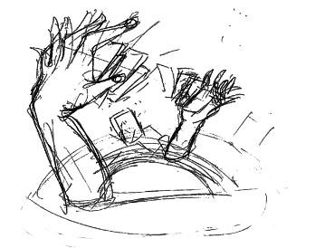
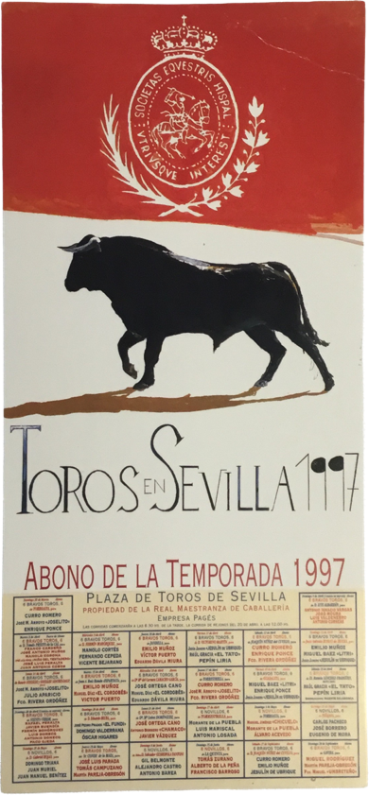
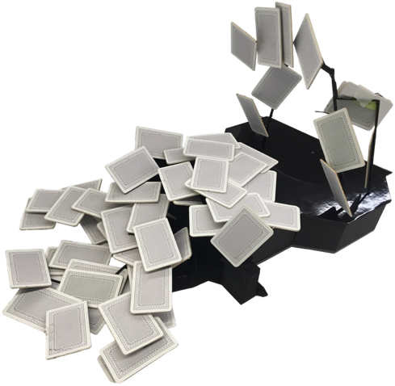
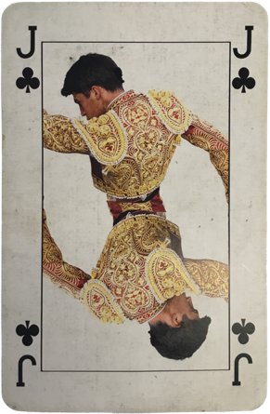
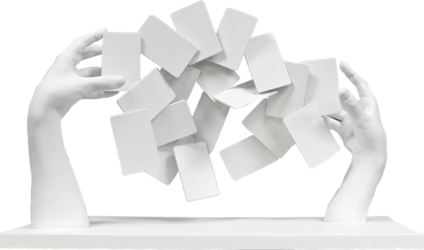
exhibition highlight 01 mêlons! coupons!
brief A set for the famous floating stage of Lake Constance in Bregenz, Austria, for Bregenz Festival 2017’s performance of George Bizet’s 1875 opera Carmen. Features a scene where the titular character repeatedly tries to read her future in a pack of cards but can find nothing but promises of death.
IMAGES – REFERENCE MATERIALS AND SKETCHES Es Devlin’s graphite sketches on paper. A Jack of Clubs playing card, print on stiff paper/card. A poster for bullfights in Sevilla, 1997, print on paper.
IMAGES – MODELS Two models document the iterative process: an earlier test arranging normal playing cards on wire was then used to inform the more polished later model incorporating hands.
Final proportions 1000m² floor area; ~22m tall x 40m wide; each card ~4.3x7m.
FINAL MaterialS / TECHNIQUES Part-submerged concrete core and 119 wooden posts supporting the ‘sea stage’, horizontal cards, and other individual components (underwater parts assembled by divers over several months). Cards were 4.3x7m solid wood, with ‘flying’ cards suspended on lightweight steel tubes and 3 central cards on a turntable. Hands were sculpted almost last, in a tent near the stage.
USE The monumental set was brought to life by 6 powerful projectors directed with pin-point accuracy, allowing the actors’ backdrop to glow, swirl and change as they climbed, ran, abseiled, swam, and rowed on and around it.
REFERENCES AND MODELS FOR CARMEN. PHOTOS: COURTESY ES DEVLIN.

Slide 6
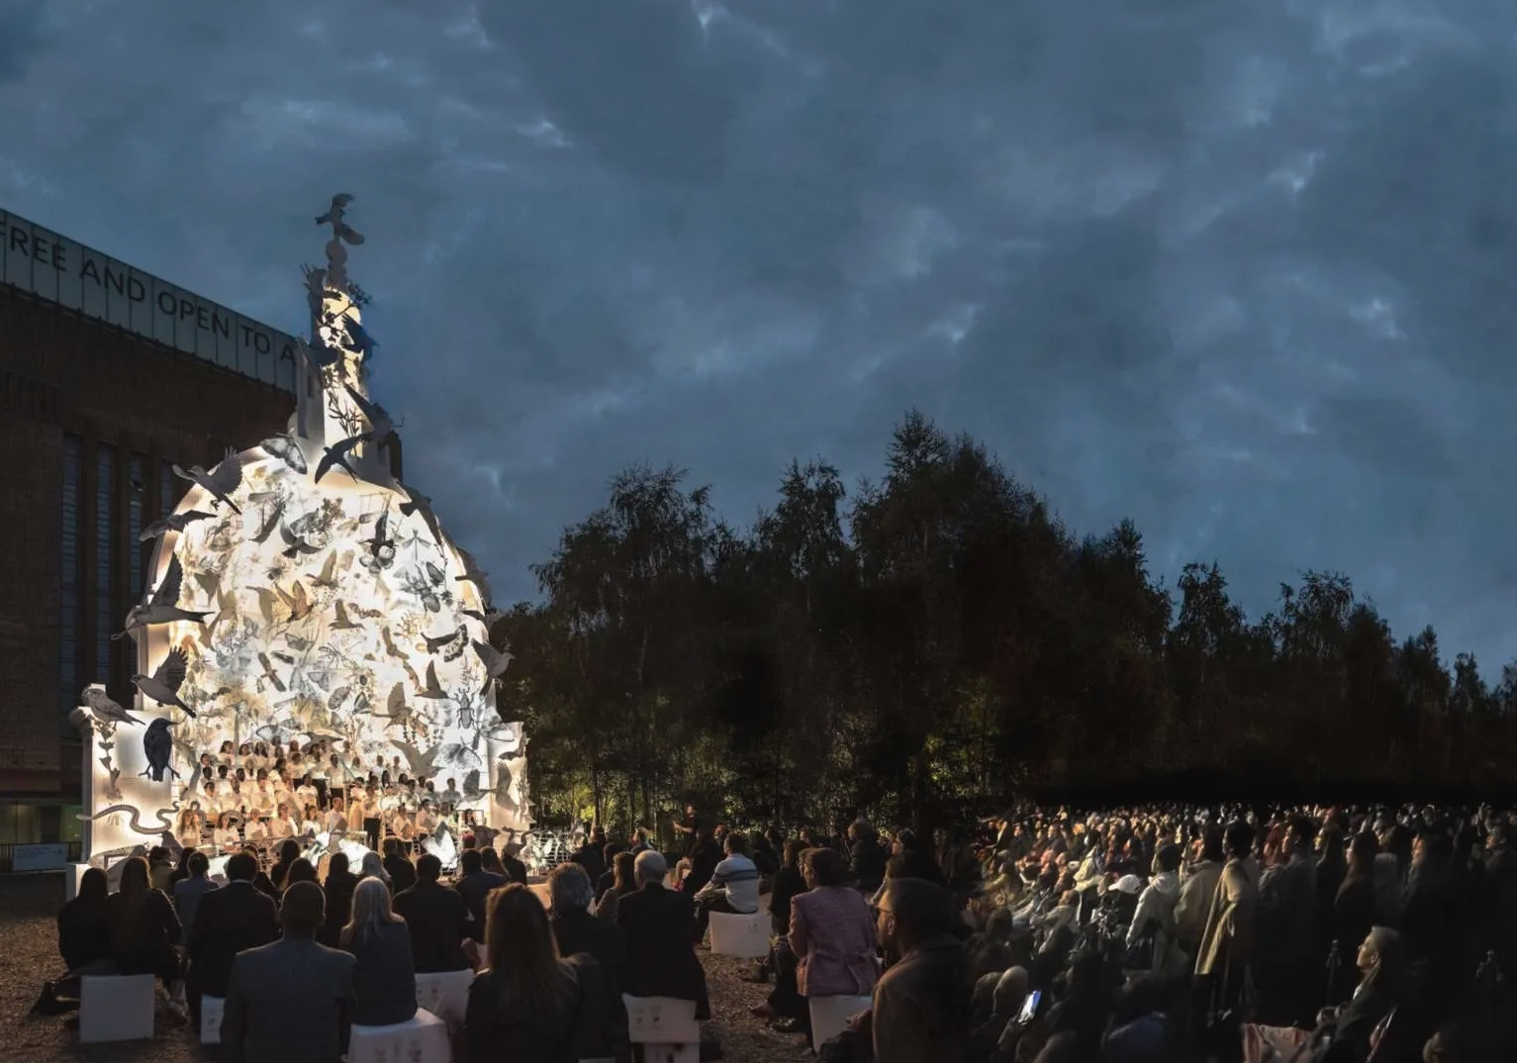
exhibition highlight 02 a portrait of Londoners
Devlin spent months drawing each of the 243 ‘priority species’ identified in the London Biodiversity Action Plan, 2019 for this public installation. Later she said that “the act of drawing taught me the porosity of my own hand”, and inspired her later piece Redraw the Edges of Yourself.
    Can you spot connections between Devlin’s other works and/or some of the sketches and experiments in the ‘Archive Unboxed’ section of the exhibition?
    Cities are often represented by their skylines, or their most iconic architecture. Why do you think Es Devlin chose St. Paul’s Cathedral for this piece in London?
    Who do you think the title of this piece, Come Home Again, might be addressing?
    What shape might you choose to represent home? Why?
“It turns out there are 15,000 species of Londoners, and only one of those species is human. The other 14,999 are birds and moths and bats and trees and woodlice and all sorts of beautiful creatures […] I thought it would be a good piece of learning to draw them and to learn their names.”
– Es Devlin
https://whitewall.art/art/drawing-the-edges-of-ourselves-es-devlin-on-art-as-activism/
COME HOME AGAIN ON DISPLAY IN THE TATE COMMUNITY GARDEN, 2022. SOUND DESIGN: POLYPHONIA. VIDEO DESIGN: LUKE HALLS STUDIO. PRODUCTION: JO MACKAY / LARMACLIVE. FABRICATION: STAGEONE & DIAGON. PROJECTION: CT. SOUND: AUTOGRAPH.

Slide 7
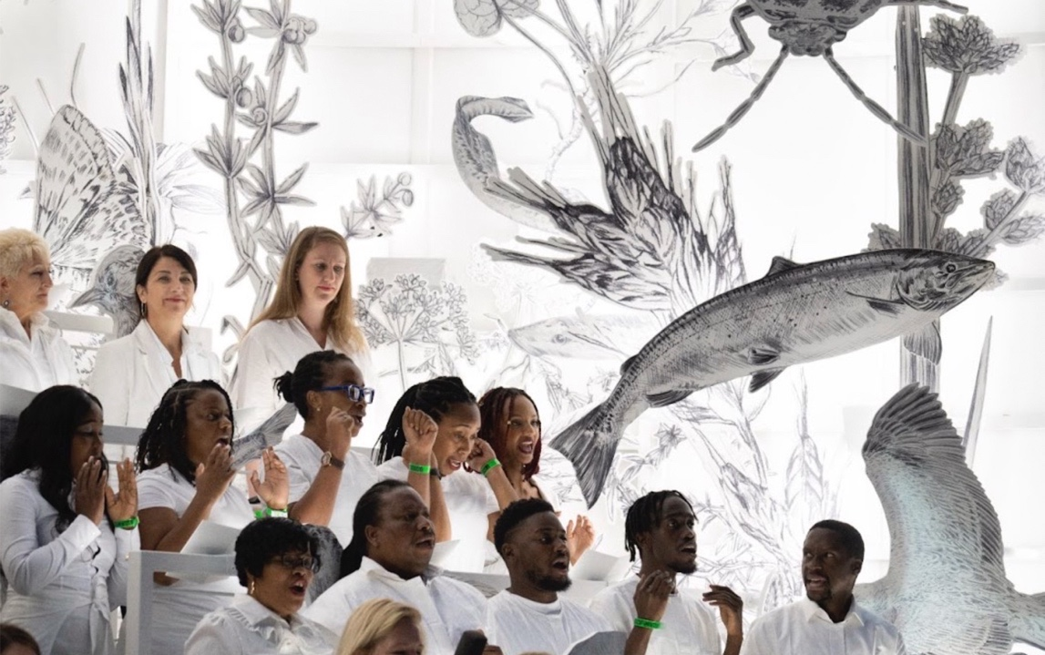
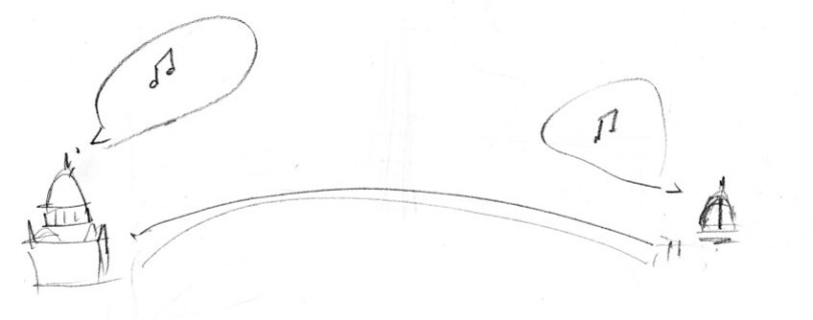
exhibition highlight 02 a portrait of Londoners
BRIEF A “portrait of Londoners” commissioned by Cartier, to be installed 22 September – 1 October 2022 in the Tate Modern Community Garden
TITLE Come Home Again
RE-INSTALLATION This is the first time the piece has been shown since its ten days outside the Tate Modern four years ago. The arrangement has been adjusted for display in this exhibition, but all cut-outs are from the original installation.
PROCESS AND FINAL BUILD Devlin spent four months hand-drawing the cut-outs, each one made of sustainably sourced birch ply. The final ⅓-scale model of St Paul’s dome stood 16m tall, supported on a recycled steel frame. Choral risers were built into the base to provide seating for daytime visitors and evening performers.
USE Blending public artwork, sculpture, choral performance space, and biodiversity awareness campaign. By day, the dome was a sculpture and a sanctuary for quiet contemplation, with handrails and an access ramp ensuring all visitors were able to sit on the risers and listen to the sounds of their non-human neighbours. As night fell, the dome was transformed into a stage for a diverse array of London choirs to highlight that “the diversity of the ethnosphere is endangered in parallel with that of the biosphere”. Devlin worked with regular collaborators Luke Halls Studio on the video animations projected in the evening, and sound design and music composition studio Polyphonia to create the soundscapes and music that wove human voices together with recordings of the 243 species represented.
CHORAL PERFORMANCE IN COME HOME AGAIN AT THE TATE MODERN. 2022. SOUND DESIGN: POLYPHONIA. VIDEO DESIGN: LUKE HALLS STUDIO. PRODUCTION: JO MACKAY / LARMACLIVE. FABRICATION: STAGEONE & DIAGON. PROJECTION: CT. SOUND: AUTOGRAPH.
INITIAL SKETCH FOR COME HOME AGAIN. 2022. IMAGE: COURTESY ES DEVLIN.

Slide 8
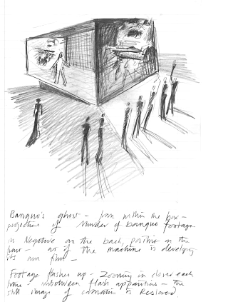
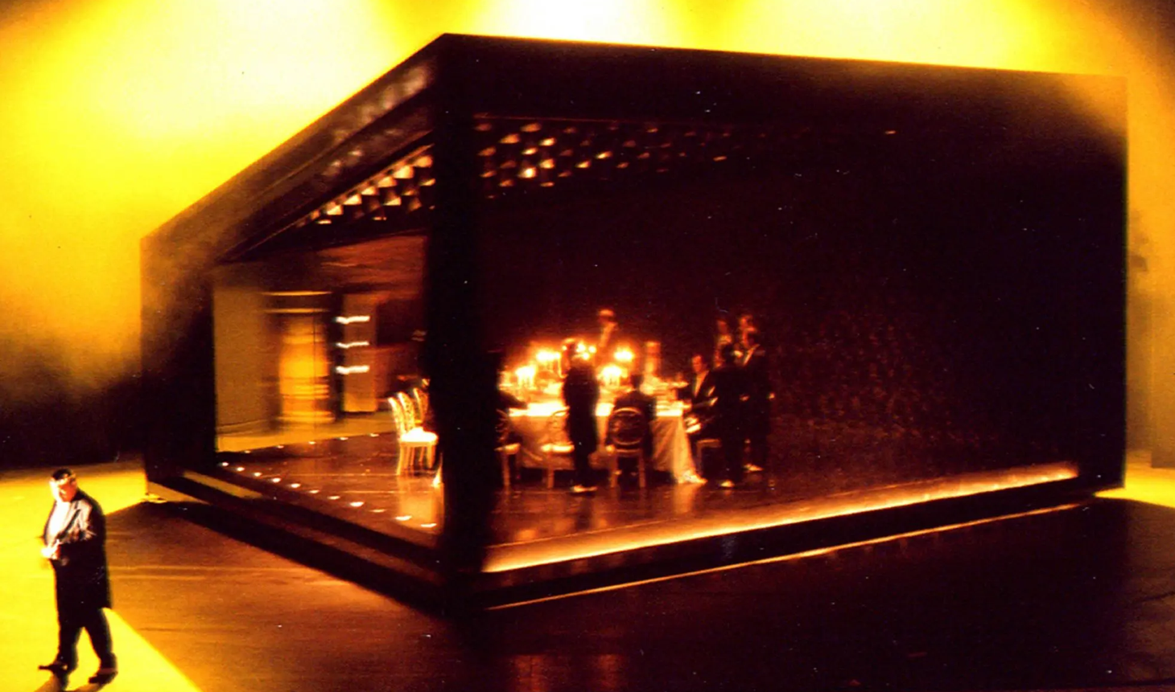
exhibition highlight 03 double, double…
    Devlin created an innovative revolving, mirrored set for a 2003 performance of Ernest Bloch’s opera of Macbeth. It was only the 15th performance of Bloch’s 1910 piece, but the source material has been re-interpreted many times around the world since William Shakespeare first wrote it in Elizabethan England c.1606.
    What do you think changes when you're designing for an opera (or stage musical!) instead of a spoken prose play?
    Can you think of other unexpected retellings or adaptations of a story you know? What works well? Why?
BANQUO’S GHOST APPEARING IN A CAMERA OBSCURA-ESQUE BOX ONSTAGE. ES DEVLIN 2002/3. GRAPHITE SKETCH ON PAPER.
PRODUCTION STAGED IN THEATER AN DER WIEN, VIENNA, AUSTRIA. 2003. DIRECTOR: KEITH WARNER. LIGHTIN`G DESIGN: WOLFGANG GOEBBEL. PHOTO: HTTPS://ESDEVLIN.COM/.

Slide 9
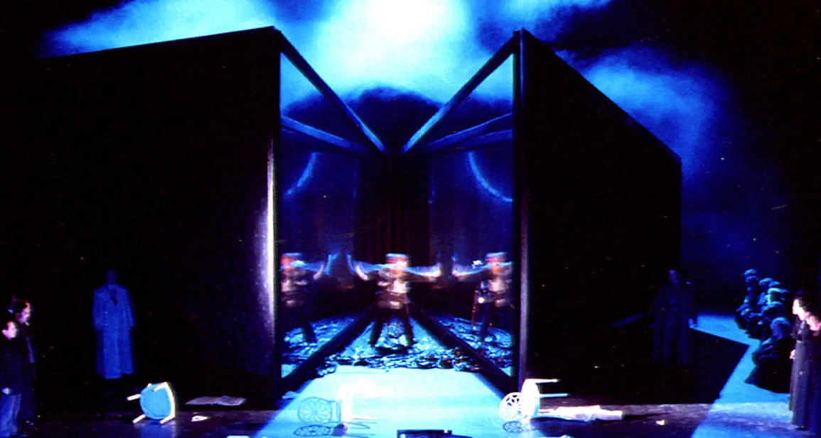
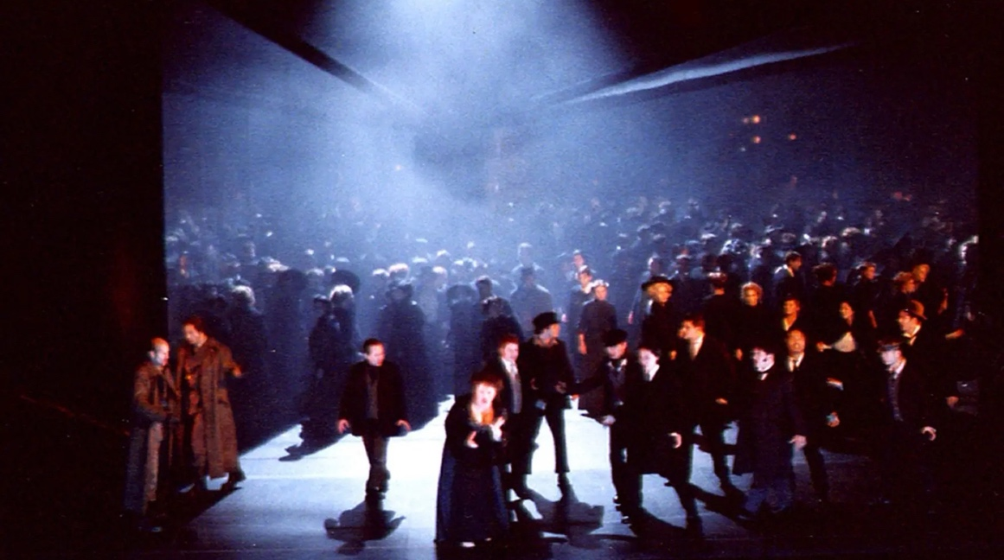
exhibition highlight 03 double, double…
VENUE Theater An Der Wien, Vienna, Austria. 2003. Director: British opera director and designer Keith Warner. Design: Es Devlin.
NARRATIVE SETTING The story was ambiguously placed in terms of time and place, but weaponry (rifles, pistols, swords), battlefield imagery, and some costume choices did evoke WWI.
SPACE The set was anchored by a cube with a mirror running diagonally through its centre, splitting, doubling, obscuring, or suddenly revealing action and transitions onstage. This was one of Devlin’s first uses of the cube motif and of mirrors, both of which she has since returned to again and again.
USE The rotating, bisected cube meant action could shift in front of the audience’s eyes, for instance transitioning from a bustling dinner party to Banquo’s ghost alone in a room. It could also split into two mobile halves to double-mirror or appear to swallow up the action within, creating the illusion of Macbeth being torn apart by his own conscience or swarmed by the infinite army of Birnam Wood.
SYMBOLISM The mirror echoes Macbeth’s themes of disguise, delusion and duality. The cube around it was described by one Austrian reviewer as “reminiscent of a small cinema, or the unadorned casing of an old camera”. Like a cinema or a camera, it created the illusion of vastness and moving between time and place in the blink of an eye.
PRODUCTION STILLS, MACBETH. DIRECTOR: KEITH WARNER. LIGHTING DESIGN: WOLFGANG GOEBBEL. PHOTO: HHTTPS://ESDEVLIN.COM/.

Slide 10
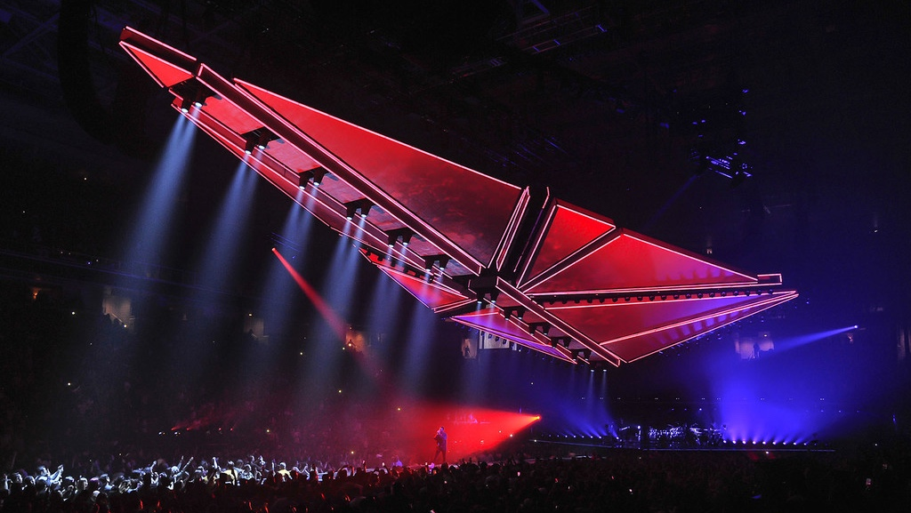
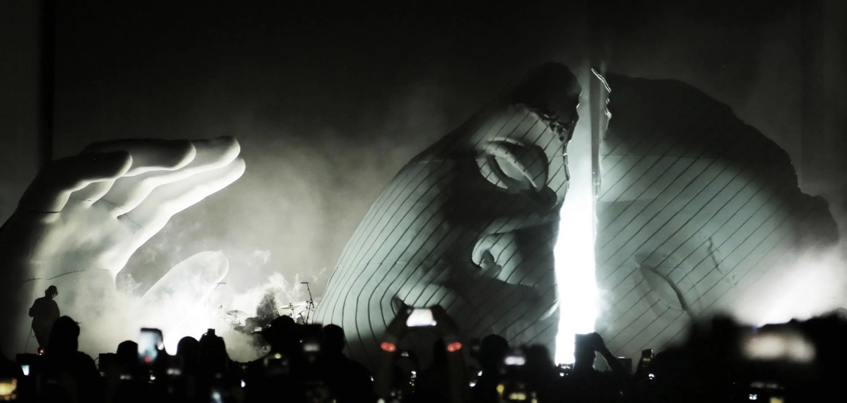
exhibition highlight 04 stage sculptures
    As of August 2026, Es Devlin has worked with Abel Tesfaye (stage name ‘the Weeknd’) seven times across festivals, concert tours, and live TV performances.
    What might be the pros and cons of repeatedly working with the same people? What might need to change across these different types of musical performance?
    Can you think of other ‘frequent collaborators’ in music, design, film, art, etc.?
  Both of these monumental sets – made only one year apart from each other – transformed in front of the live audience. Can you guess how just from looking at these images?
  Many musicians cultivate a persona or ‘brand’ over the course of each album, or maintain one for their entire career. Can you think of other musicians known for their ‘stage personas’, whether these change with every album or remain consistent for years on end? Find images of performances by these musicians and consider how each stage design fits their ‘persona’.
‘THE LEGEND OF A FALL’ TOUR. 2017. PHOTO: HTTPS://ESDEVLIN.COM/.
“I call my work stage sculpture, but of course what’s really being sculpted is the experience of the audience, and as directors and designers, we have to take responsibility for every minute that the audience spend with us. We’re a bit like pilots navigating a flight path for a hundred thousand passengers.”
– Es Devlin
https://www.ted.com/talks/es_devlin_mind_blowing_stage_sculptures_that_fuse_music_and_technology
TESFAYE (‘THE WEEKND’) AT COACHELLA. 2018. CONSTRUCTION: AES. CONCEPT: THE WEEKND, XO, ES DEVLIN. DESIGN: ES DEVLIN. VIDEO: STRANGELOOP. LIGHT: JASON BAERI. LEAD ASSOCIATE DESIGNER: JACK HEADFORD. PHOTO: HTTPS://ESDEVLIN.COM/.

Slide 11
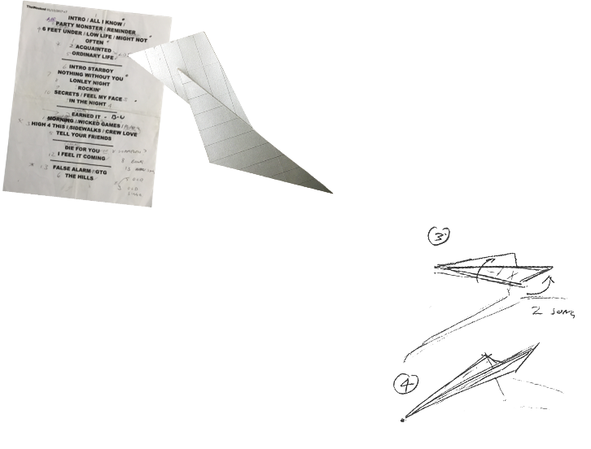
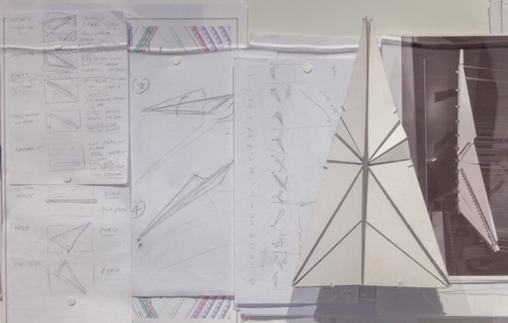
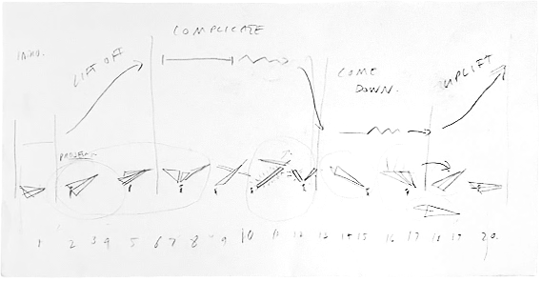
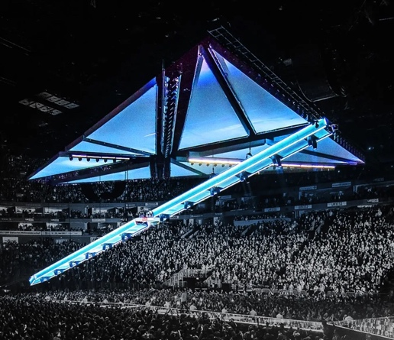
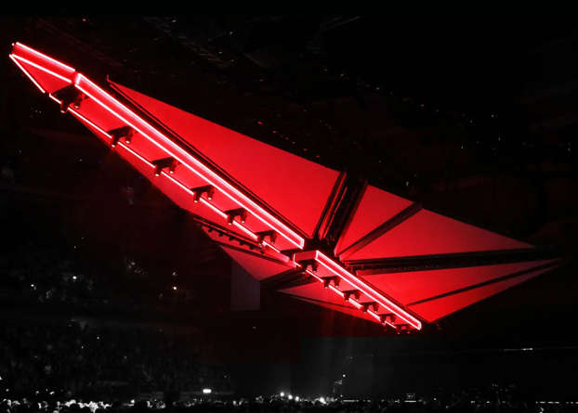
exhibition highlight 04 stage sculptures – the Legend of the Fall
BRIEF A 2017 world tour of Europe and North America promoting Tesfaye’s album Starboy (2016). He told Devlin that he wanted “an intergalactic craft to transport the audience to other worlds”.
PROCESS MATERIALS Devlin's graphite sketches and an annotated set-list for the tour show how she mapped the arc of each show as a flight path: lift-off, cruise, crash, relaunch. Folded paper models and an annotated paper-aeroplane study show how she formulated the physical structure and appearance of the design, and how it would fold and move.
FINAL MATERIALS / TECHNIQUES A lightweight aluminium truss formed the anchor for ten small, LED-outlined triangular display panels, each able to independently tilt and rotate around the underlying structure. Mapped video projection, tracked live by TAIT, moved accurately across the structure as it physically transformed.
USE The tour opened in Stockholm in February 2017. Live on stage, the structure dove nose-first and split its wings apart, physically enacting each stage of the “flight path” alongside Tesfaye’s music. A hybrid between a simple paper aeroplane and a science-fiction Star Destroyer, the retrofuturist final product provided a fitting accompaniment to Tesfaye’s musical blend of analogue soul and electronica.
PROCESS MATERIALS AND PHOTOS FROM ‘THE LEGEND OF THE FALL’. 2017. DIRECTION: ABEL TESFAYE / THE WEEKND, LAMAR C TAYLOR, XO, ES DEVLIN. DESIGN: ES DEVLIN. LIGHTING DESIGN: SOONER ROUTHIER. LEAD ASSOCIATE DESIGNER: JED SKRZYPCZAK.

Slide 12
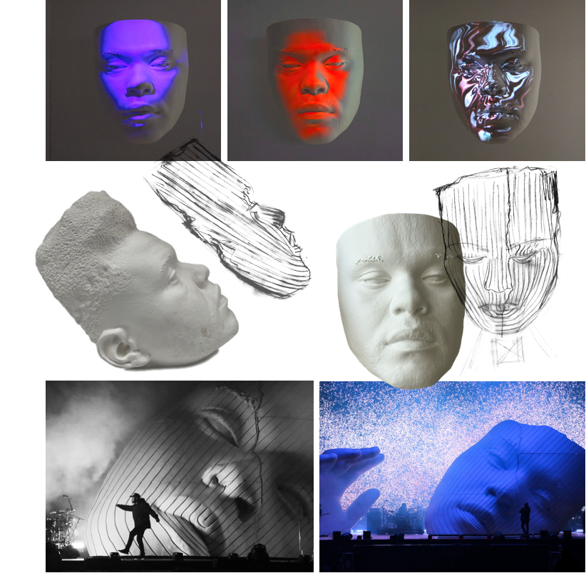
exhibition highlight 04 stage sculptures – Abel’s mask
BRIEF 2018 marked Tesfaye’s third time performing at the famous Coachella music festival in California, USA. He was inspired by his recent work with Kendrick Lamar on the Black Panther (2018) soundtrack to bring Afrofuturist sculpture into the show. Devlin connected this initial idea to Tesfaye’s identity as a second-generation Toronto resident with Ethiopian heritage, his ‘biculturalism’ partly inspiring the dramatic scar or crack seen in the final design. She “found common ground” between this and her own long-running interest in “pop portraiture” – stage personas, masks, make up.
PROCESS MATERIALS Devlin and Tesfaye researched “the linear, scarred inscriptions on Ethiopian masks” together, documented in some of Devlin’s sketches seen here. These formed the basis of the textures overlaid onto digital scans of Tesfaye’s head using CAD (Computer-Aided Design). These digital renders could then be 3D-printed in miniature, all allowing for multiple rounds of reiteration with minimal waste before deciding on the final design.
FINAL MATERIALS / TECHNIQUES The final 3D render was CNC-cut ‘in negative’ to make a mould and cast the final fibreglass ‘positive’, richly detailed but strong enough to withstand desert winds. CNC stands for Computer Numerical Control, and it essentially just means using a computer to control a tool rather than a human being. This allows for a much higher level of precision and consistency than would otherwise be possible, and is ideal for complex, precise shapes and contours like those on this mask.
USE At the start of the performance, the mask cracked open to form a doorway for Tesfaye to step through before coming back together, continuing to transform throughout the show through the use of mapped projection and complementary ambient/background lighting.
PROCESS MATERIALS AND PHOTOGRAPHY FROM THE WEEKND AT COACHELLA. 2018. CONSTRUCTION: AES. CONCEPT: THE WEEKND, XO, ES DEVLIN. DESIGN: ES DEVLIN. VIDEO: STRANGELOOP. LIGHT: JASON BAERI. LEAD ASSOCIATE DESIGNER: JACK HEADFORD. PHOTOS: HTTPS://ESDEVLIN.COM/ AND ELLIOT GOLDSTEIN © SMITHSONIAN INSTITUTION

Slide 13
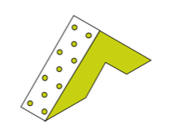
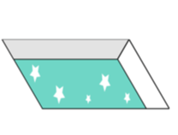
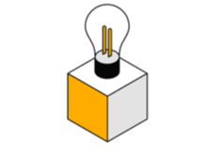
what next?
evaluate
(re)imagine
explore
Devlin’s “stage sculptures” are artworks that need to exist and function in the real world: to be used or interacted with, while fulfilling safety requirements and sometimes enduring harsh weather conditions.
Pick a final design from Devlin’s body of work and consider how form and function have been balanced. What alternative options might have been considered? Why do you think Devlin and her collaborators made the choices they did?
Devlin has returned to Shakespeare throughout her career, with Macbeth and three different productions of Hamlet under her belt.
Consider a narrative you know well: how might it change if it was set in a completely different time or place? It could be past, future, distant, near, totally alien or utterly familiar. What does each setting add, highlight, distort or downplay within the story?
Come Home Again portrays over 200 “London priority species” including plants, animals, insects, and fungi.
Build a field journal of your local wildlife in its habitat: a garden, a nearby park, a crack in the pavement, a cobwebbed corner. Research what you find, noting anything interesting alongside your own first-hand observations.
What do your drawings reveal that a photograph wouldn't? Does your research make something that seemed strange make more sense? Does the process change how you feel about your non-human neighbours?

Slide 14
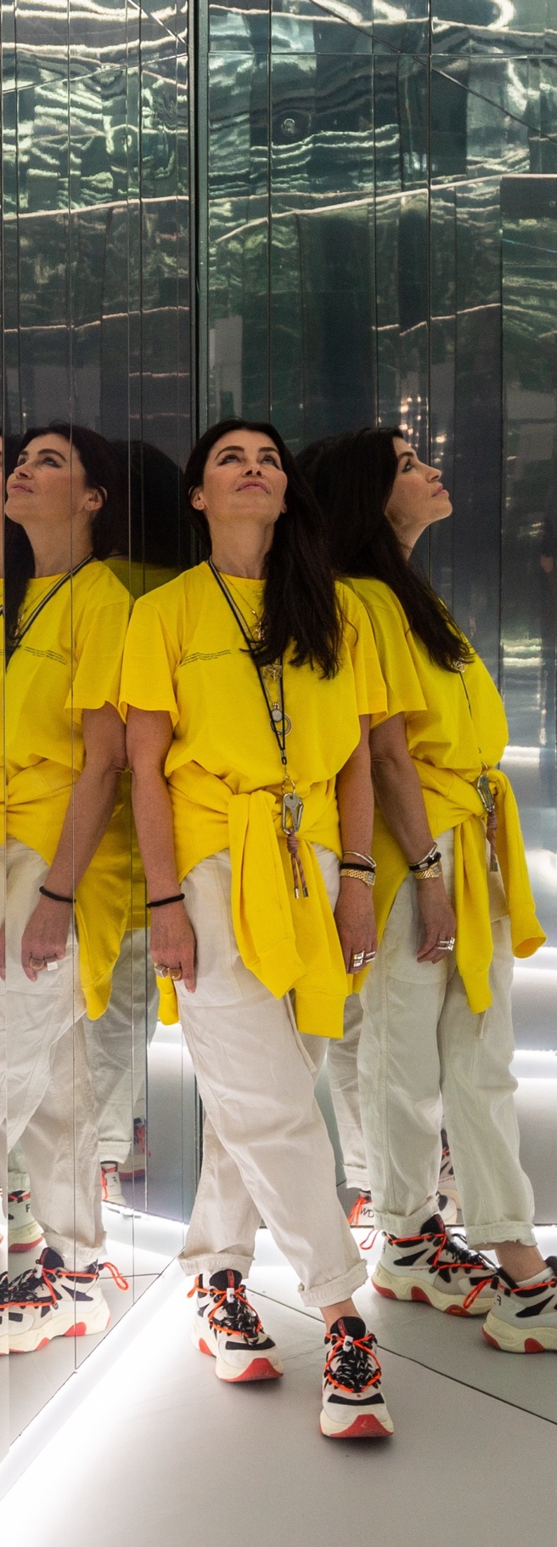
learn more
Devlin’s website and searchable, filterable online portfolio. https://esdevlin.com/
The Cooper Hewitt’s ‘virtual exhibition’ produced alongside their show An Atlas of Es Devlin. Introduction: An Atlas of Es Devlin (2023). Cooper Hewitt Smithsonian Design Museum [Online]. https://exhibitions.cooperhewitt.org/es-devlin/category/es-devlin/.
Interview for London Design Week. Fulleylove, R. (2018). Es Devlin on her creative process and embracing mistakes. Google Arts & Culture [Online]. https://artsandculture.google.com/story/es-devlin-on-her-creative-process-and-embracing-mistakes/gAWx4tUEpwQkLg.
A visual tour of Devlin’s creative process. Devlin, E. (April 2019). Mind-blowing stage sculptures that fuse music and technology. TED [Online video recording]. https://www.ted.com/talks/es_devlin_mind_blowing_stage_sculptures_that_fuse_music_and_technology
Inside perspectives on Come Home Again: Cartier (brief-setter): https://2022.365ayearof.cartier.com/en-us/article/come-home-again-a-choral-sculpture-of-biodiversity/. Stage One (fabrication): https://www.stageone.co.uk/project/come-home-again/. Tenebrae (one of the choirs): https://www.tenebrae-choir.com/events/2022/09/30/come-home-again.
Devlin’s inspiration and details of some of the technical innovations required for Carmen: Video interview, including clips of stage in use: https://www.youtube.com/watch?v=2W_qoJSEJwc Video time-lapse of the floating stage being built over the course of about 7 months: https://www.youtube.com/watch?v=XRnz1qOZfos How projection was used to bring the stage to life: https://www.avinteractive.com/news/projection/christie-boxers-set-scene-carmen-lake-stage-bregenz-festival-04-09-2018/.
More on Devlin’s work for Abel Tesfaye (the Weekend): Creative and technical process behind the Coachella ‘mask’: https://www.dezeen.com/2018/04/18/the-weeknd-set-coachella-es-devli-afrofuturist-scarred-mask/ The techniques behind ‘The Legend of the Fall’: https://www.taittowers.com/work/after-hours-til-dawn-tour

