Slide 1

How can design education work with industry to meet the changing needs of the market?
Rebecca Cain
Associate Professor in Design & Experiential Engineering
WMG, University of Warwick
@drrebeccacain

Slide 2

The number of years I haven’t worked in ‘a design school’
The number of years I have taught and researched design, with industry

Slide 3
Before WMG…
BA Industrial Design
PhD Co-designing and prototyping
All at Loughborough University

Slide 4
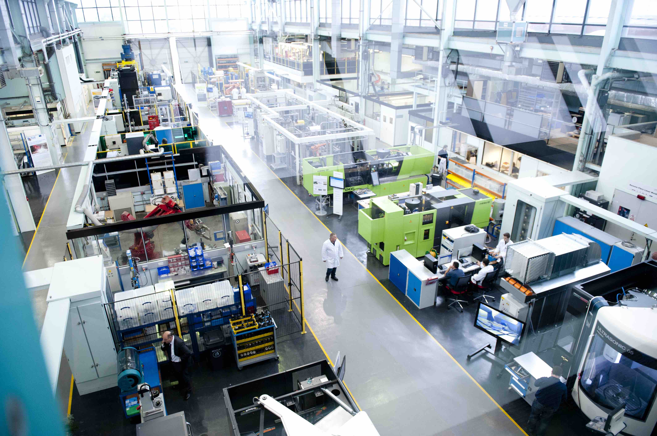

Slide 5
Being comfortable with being uncomfortable

Slide 6

Skip forward a few years…building a multi-disciplinary team
electrical engineer
environmental psychologist
computer scientist
scientist and MBA
human factors
designer

Slide 7
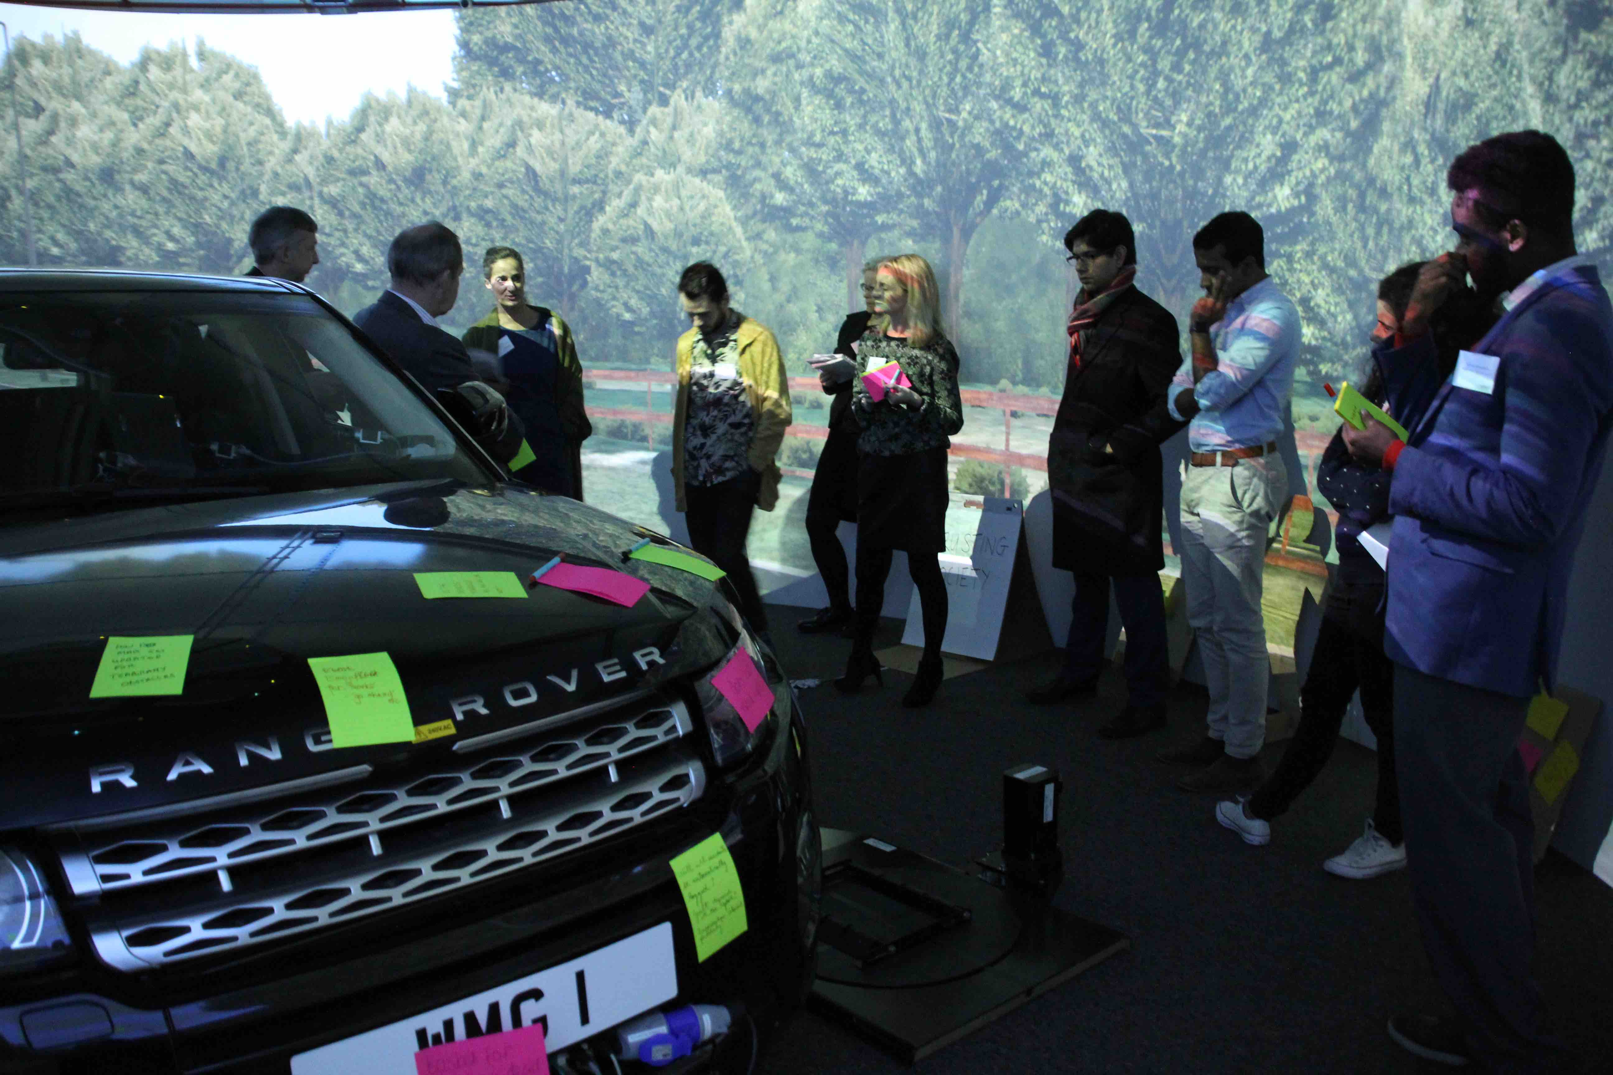
Design research in an engineer’s world

Slide 8
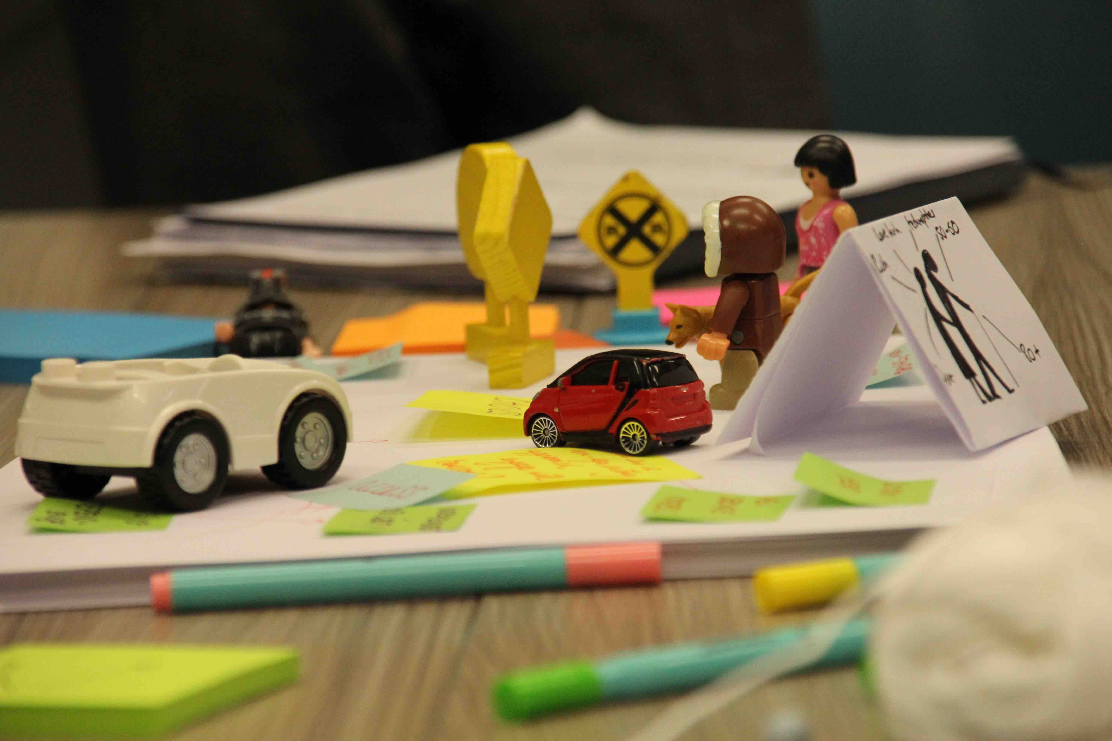
…and making engineers move out of their comfort zone

Slide 9
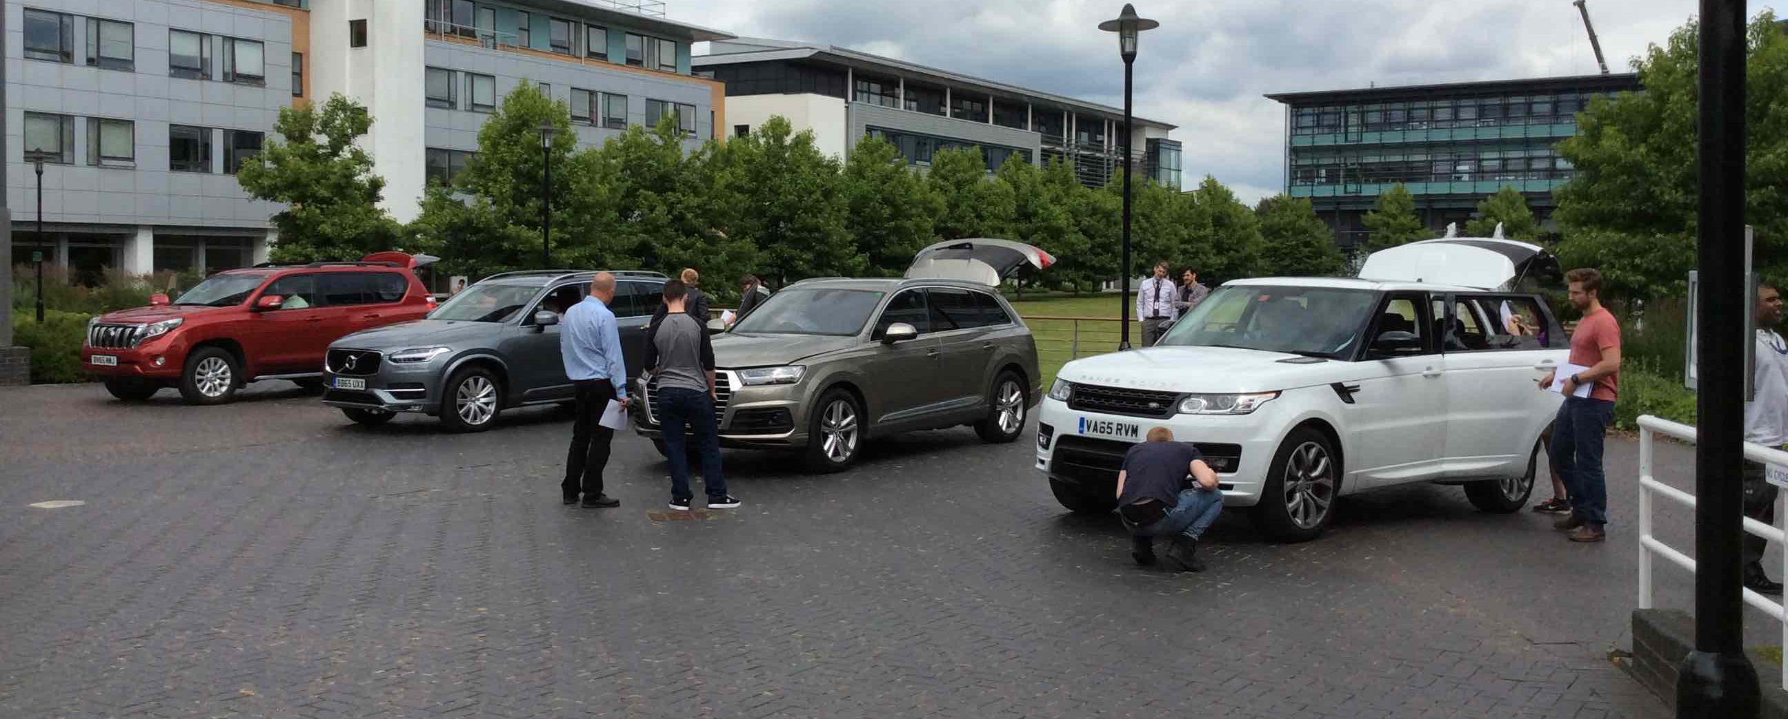
Education
engineering, business, healthcare

Slide 10

I’m Rebecca and I’m a transdisciplinary designer
A specialist in being a generalist

Slide 11

So why does transdisciplinary matter for industry?

Slide 12
Big design in a fast world

Slide 13
specialised design disciplines

Slide 14
BIG Design
meta design
collaborative team working
business
science
specialised design disciplines
psychology
engineering
social sciences
technology
problem creating
purpose-driven
human-centred

Slide 15

Digital transformation

Slide 16
design
other internal teams
customers
- business
- technology
- commercial
- human-centred
- experiential
- purpose-driven

Slide 17
New
Designer
New
Designer
design
other internal teams
customers
- business
- technology
- commercial
- human-centred
- experiential
- purpose-driven

Slide 18

a new type of undisciplined designer
Inter-disciplinary
Multi-disciplinary
Trans-disciplinary

Slide 19
When mixing disciplines works…

Slide 20
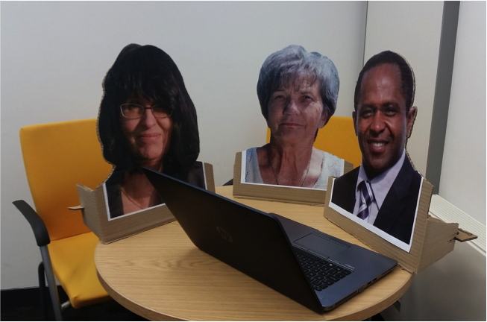
To disrupt an engineering project have a philosopher join your team…

Slide 21
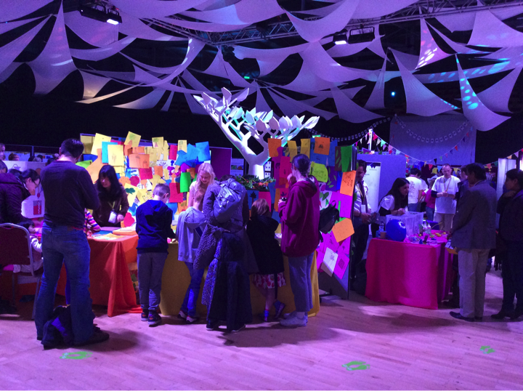
Design meets science

Slide 22
And when mixing disciplines is challenging…

Slide 23
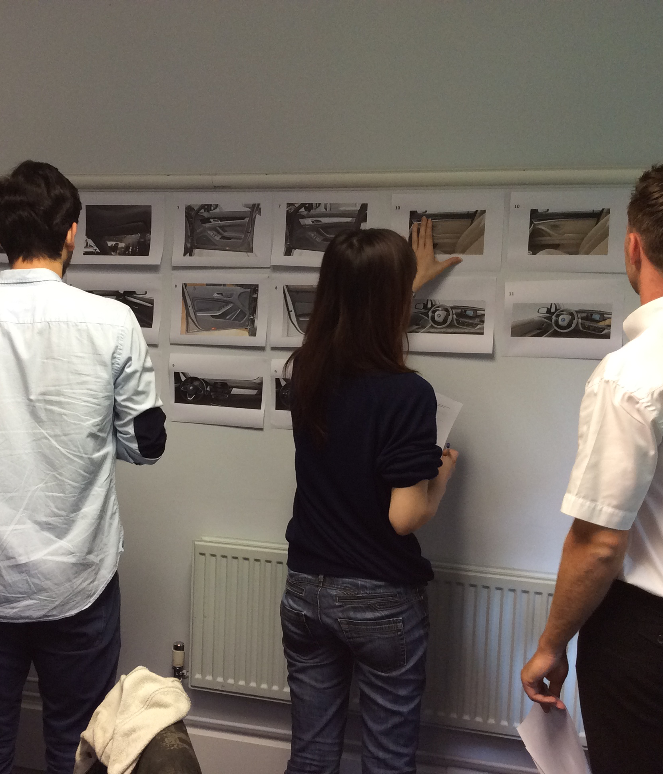
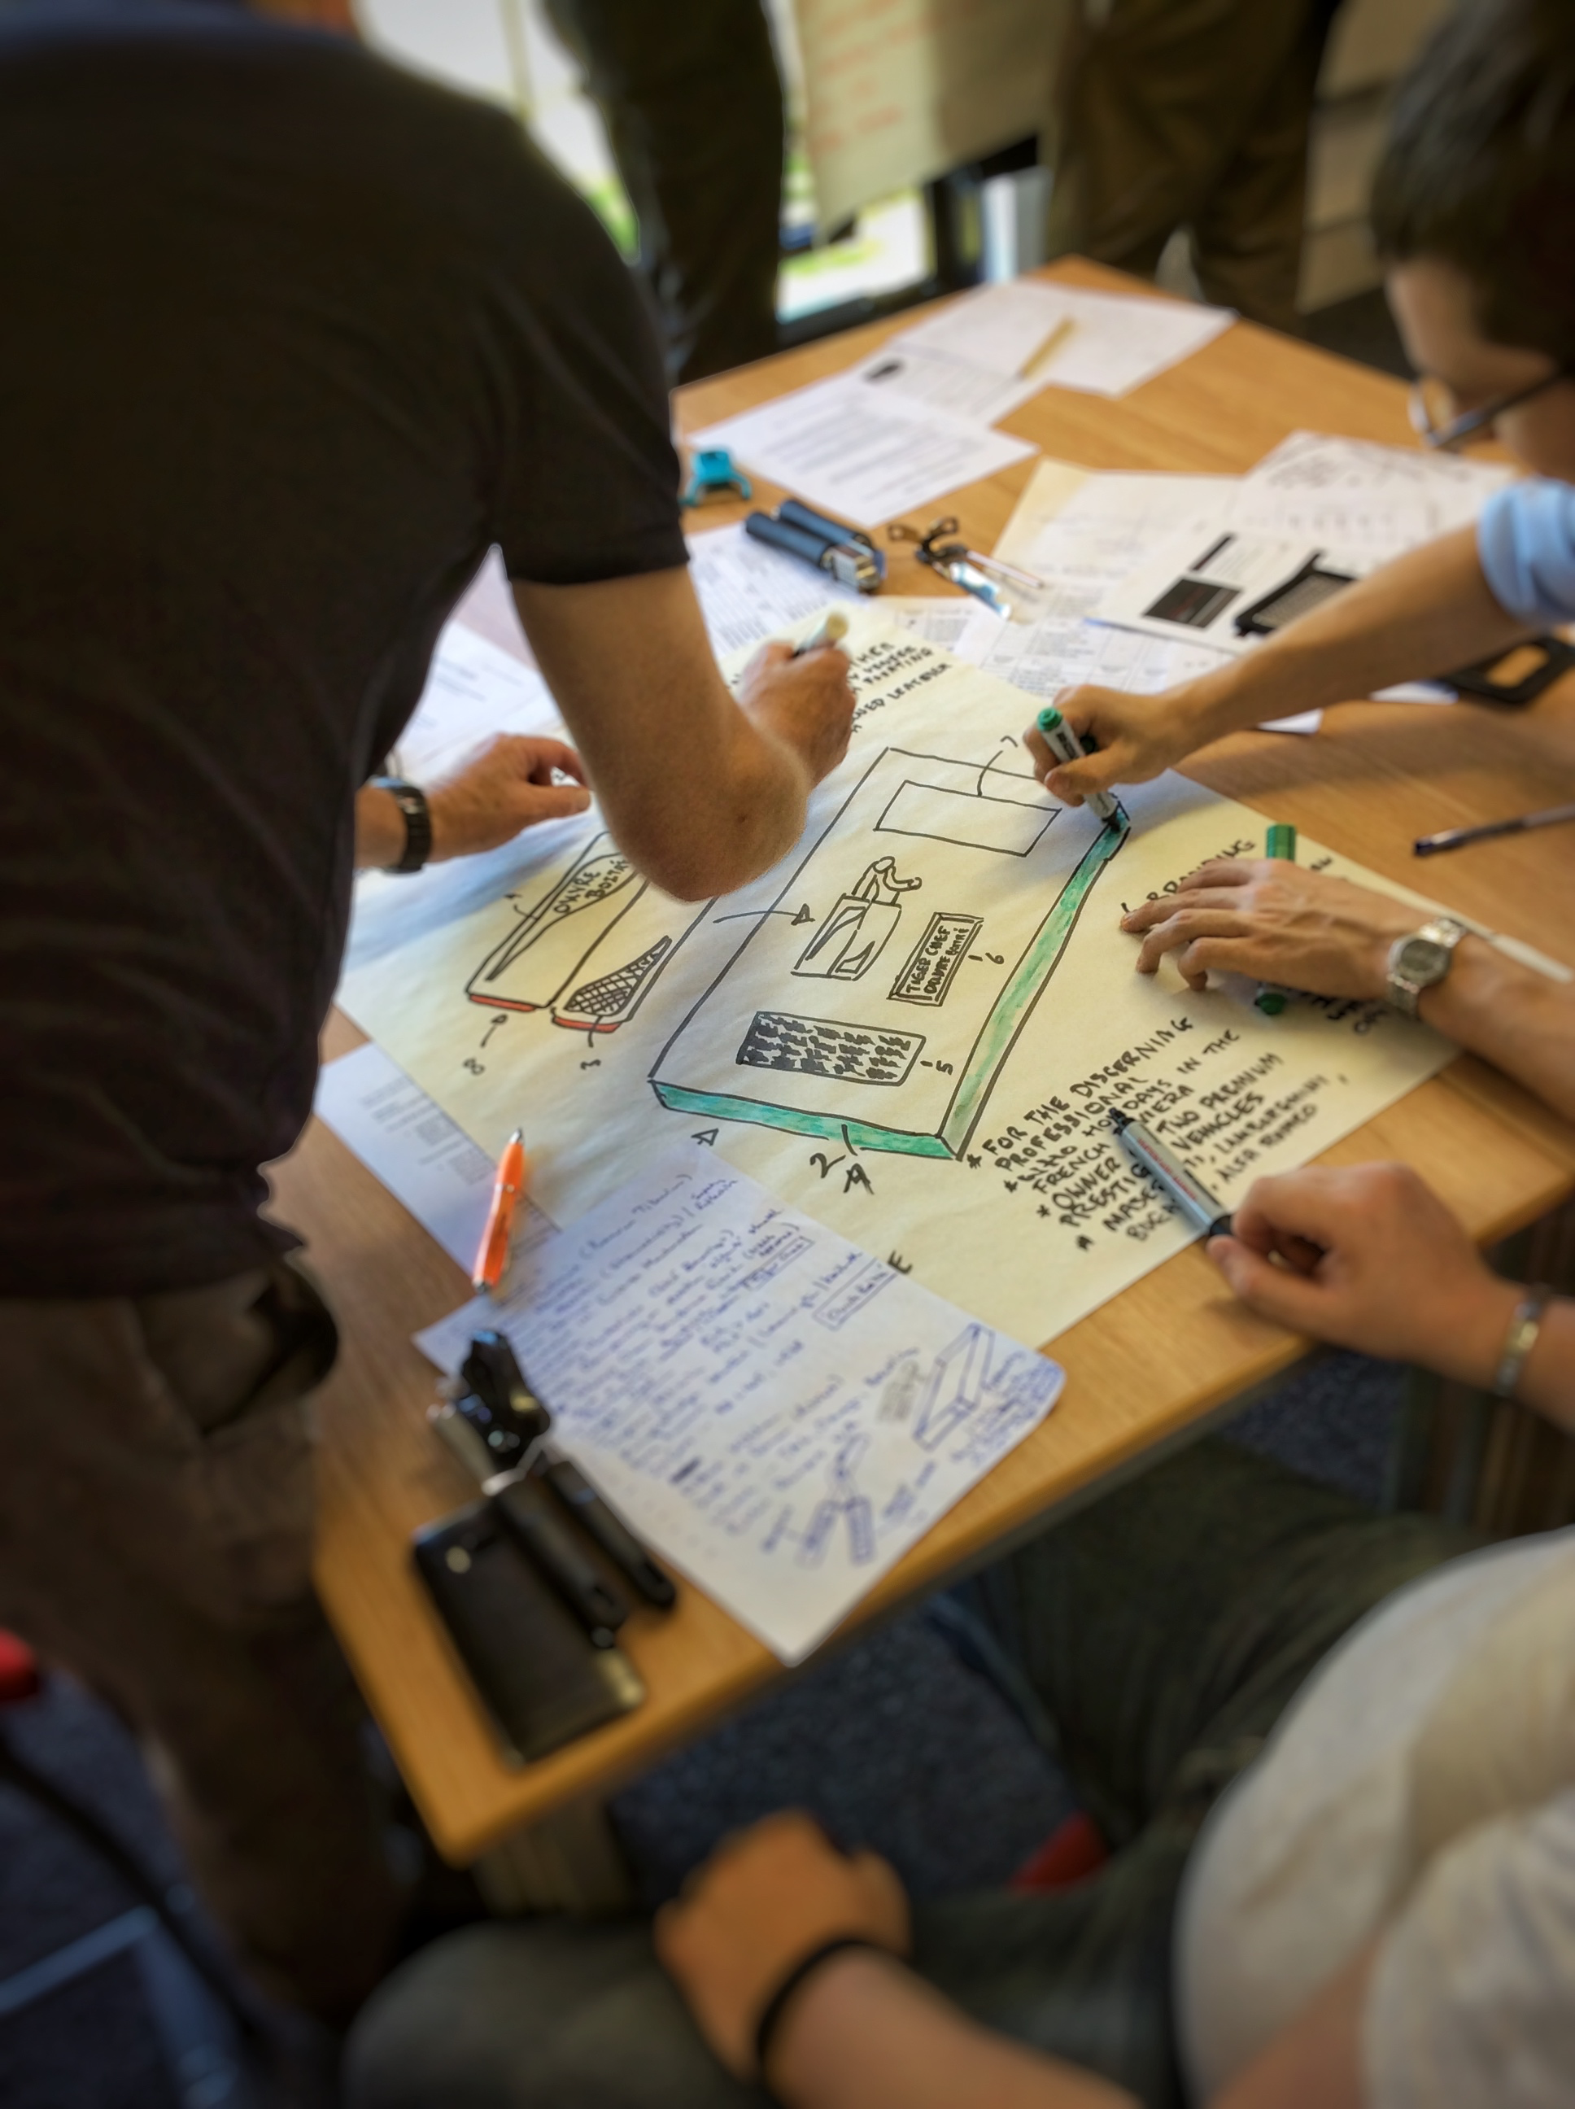
Finding a common language
Engineers designing

Slide 24

Identity

Slide 25

If we aspire to have transdisciplinary students…
what, as educators, are we bringing to this?

Slide 26
Who is educating at the overlaps and intersections?
New Designers

Slide 27
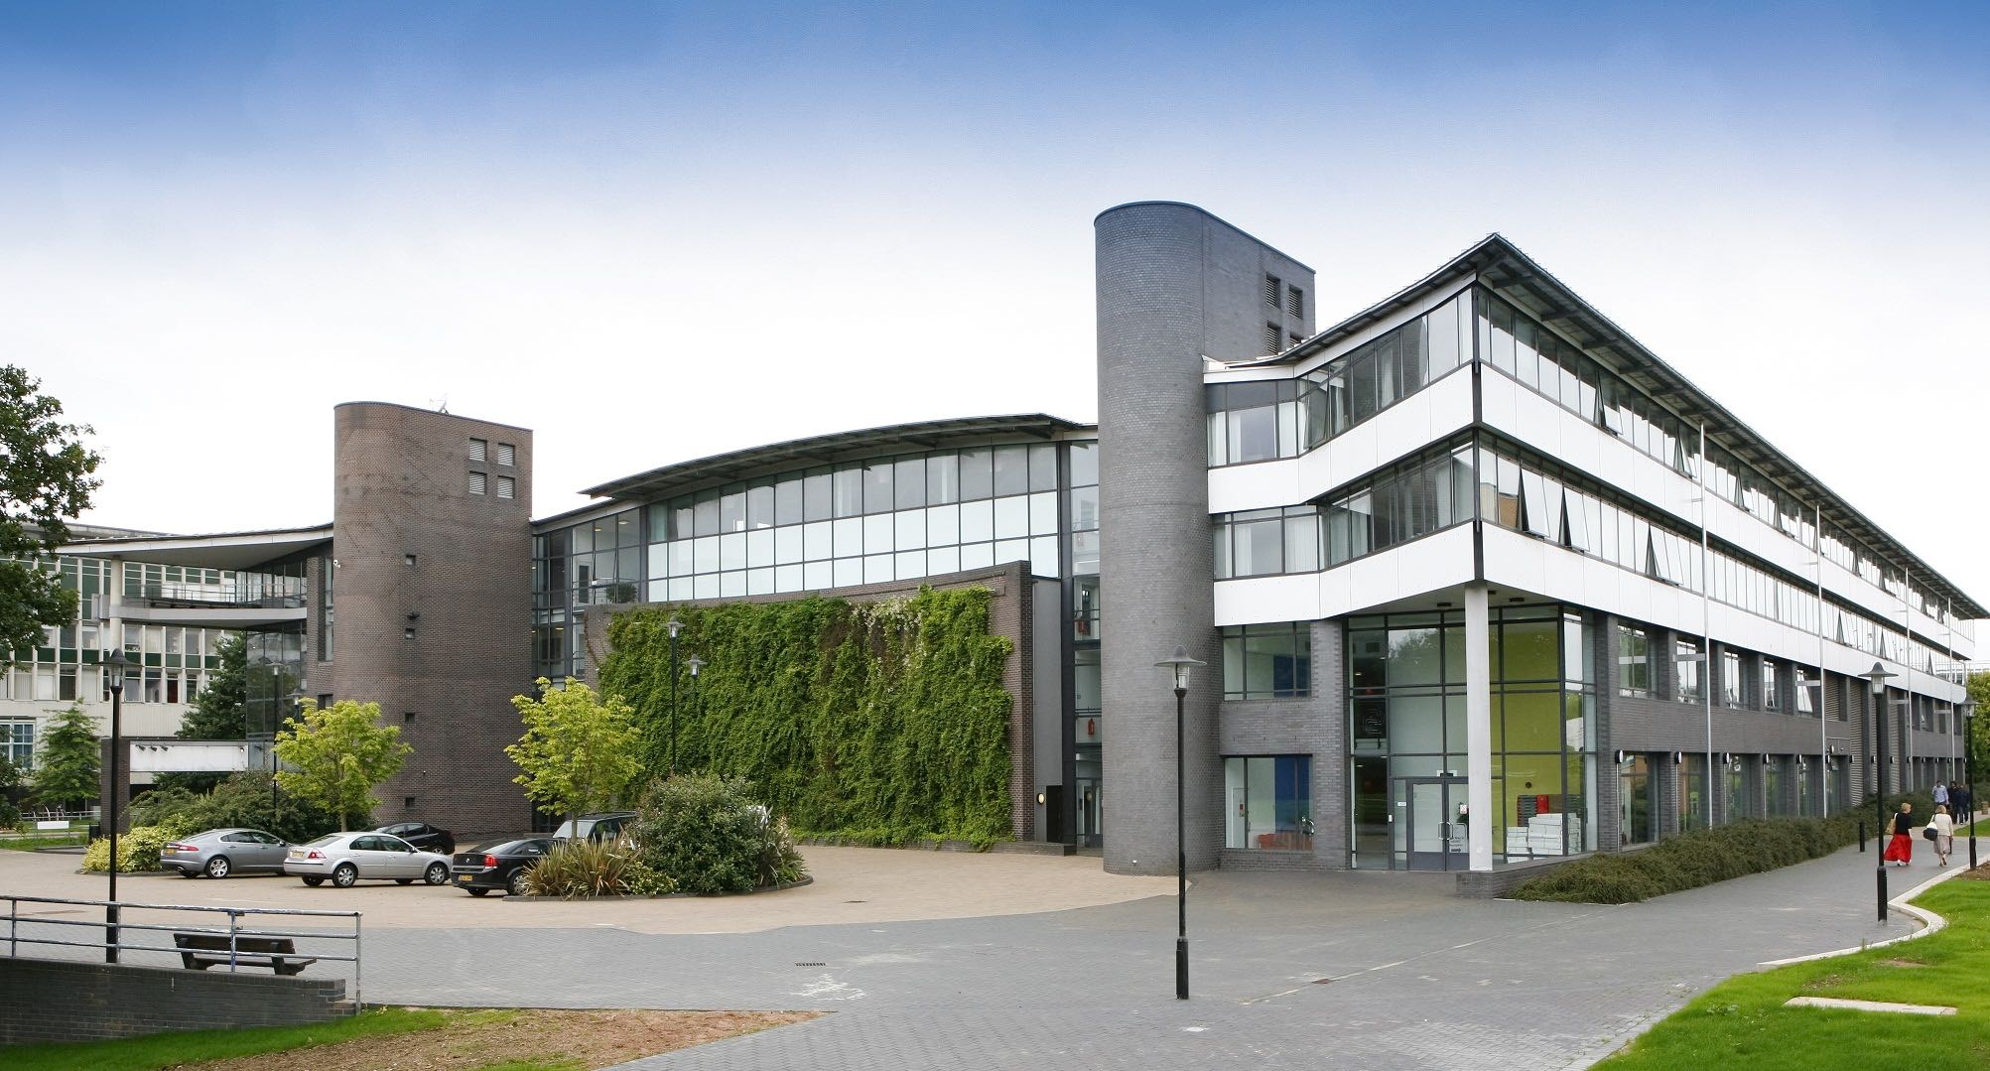
WMG – an international role model for how businesses and universities can work together

Slide 28
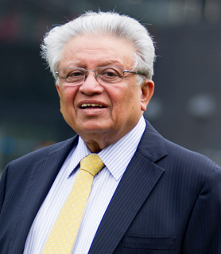
“Academic excellence with industrial relevance has always been at the heart of what we do… it’s what makes us unique”.
Professor Lord Bhattacharyya
Kt CBE FREng FRS
Regius Professor of Manufacturing
Chairman and Founder

Slide 29
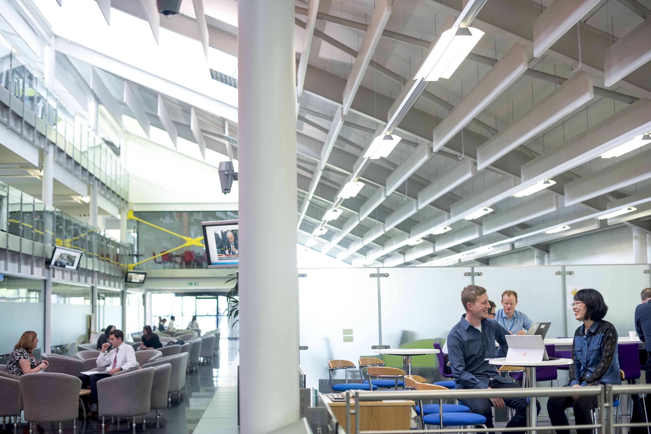
Full and part-time Engineering degrees
BEng Applied Engineering program (for people in full-time employment or as part as a degree apprenticeship)
Dyson Engineering Degree
Overseas programs for postgraduates in China, Cyprus, India, Malaysia, Singapore, Thailand and Turkey
Professional and Executive Education
And two Academies for young engineers (age 14-18)

Slide 30
Doctorates

Slide 31

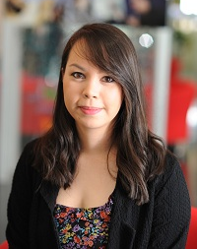
Duncan
Industry-funded part-time PhD
Claudia
Industry-sponsored EngD

Slide 32

DesD ?

Slide 33

WMG Education – choice, flexibility and continuous learning, developed in collaboration with industry
Where does design play into this?

Slide 34
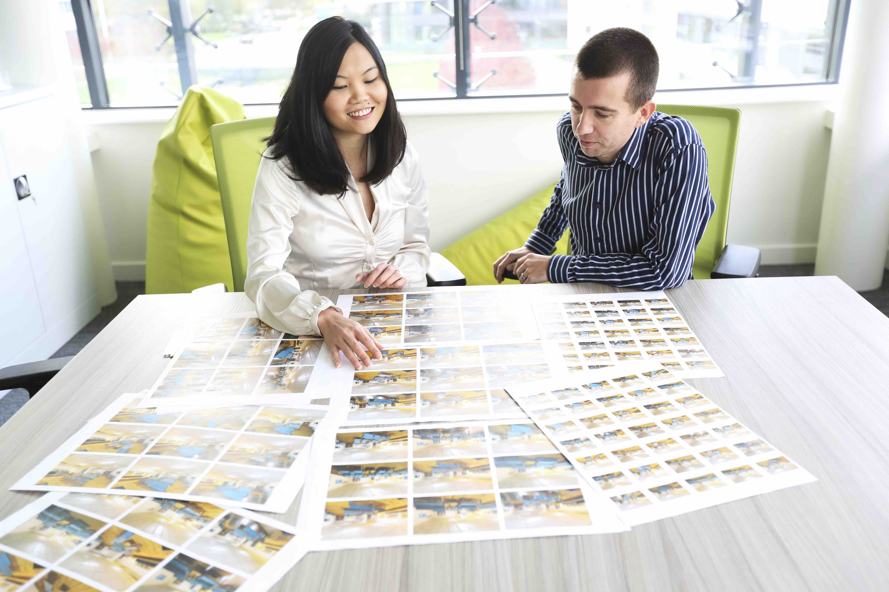

Design@WMG
‘open’ centre
design education for industry

Slide 35
Design education should be leading, not following.
Design education should be continuous, life-long education.
Design education should have the flexibility to be quick to react to industry need.
We should practice what we teach and take creative approaches to designing education in partnership with industry.

Slide 36


Slide 37
Thank you.
@drrebeccacain
R.Cain.1@warwick.ac.uk

